Slide 1
Workforce Development Spotlight: November 2021 A Summary of Upcoming Career Compass and WFD Opportunities
New Content Coming Your Way!
Live Webinars Coming This Month
Building an Accountability Framework (Accountability; Intermediate Level) – 30 Nov & 02 Dec
https://www.navfac.navy.mil/jobs/workforce-development/ccrc/emp_resources/comp_dev_content/accountability.html
SYSCOM Training Opportunities
Please see the following page. The Career Compass Event Calendar has been updated to include all upcoming learning opportunities and trainings across SYSCOM.
https://www.navfac.navy.mil/jobs/workforce-development/ccrc/event-calendar.html
On-Demand Webinars and Resources Coming This Month
Accountability– Awareness/Basic Levels (early Nov)
On-Demand Webinar: Creating a Culture of Personal Accountability
Video: Personal Accountability: From Avoidance to Ownership
https://www.navfac.navy.mil/jobs/workforce-development/ccrc/emp_resources/comp_dev_content/accountability.html
Accountability – Intermediate Level (early Nov)
Podcast: How to Encourage Peer-to-Peer Accountability on Your Team
Job Aide: Creating Project Accountability
https://www.navfac.navy.mil/jobs/workforce-development/ccrc/emp_resources/comp_dev_content/accountability.html
Problem Solving – Awareness/Basic Levels (late Nov)
On-Demand Webinar: Solving Problems Through Reframing
https://www.navfac.navy.mil/jobs/workforce-development/ccrc/emp_resources/comp_dev_content/problem-solving.html
For additional details, please talk to your local Civilian Training Advocate (BD17).
*Note: If you are unable to copy and paste the links above, QR codes are available on the following page.

Slide 2
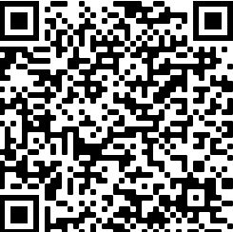
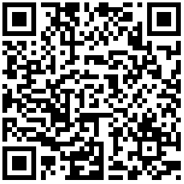
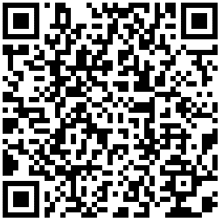
November SYSCOM Training Summary
The following QR codes can be used to access the pages referenced in the previous slide.
Start Date | Event
Mon, 01 Nov | Basic Project Management (East)
Mon, 01 Nov | Planning for Retirement for CSRS & FERS Employees (West)
Mon, 01 Nov | Planning for Retirement for CSRS & FERS Employees (East)
Mon, 01 Nov | Basic HR for Supervisors (West)
Tue, 02 Nov | Writing to Get Things Done (West)
Thu, 04 Nov | Communications (West)
Tue, 09 Nov | Speaking to Get Things Done (East/West)
Mon, 15 Nov | Speaking to Get Things Done (West)
Wed, 17 Nov | Basic Project Management (West)
Tue, 30 Nov | Building an Accountability Framework
Accountability Competency Page
Career Compass Event Calendar
December Courses Open for Registration
Start Date | Event | Registration Deadline
Mon, 06 Dec | Current Supervisor Training (East Coast Offering) | Mon, 29 Nov
Problem Solving Competency Page

